Slide 1
Aiding farmers in selecting of crop varieties

Slide 2


Agenda
A
Introduction
Primary goals
Implementation
Output
Conclusion

Slide 3
Introduction
In an era where climate change, soil health, pest resistance, and water resource availability are pressing issues, the selection of appropriate crop varieties becomes crucial for farmers. The right variety can significantly affect yields, profitability, and sustainability.

Slide 4
Primary goals
analyzing the data & predicting the crop yeild

Slide 5
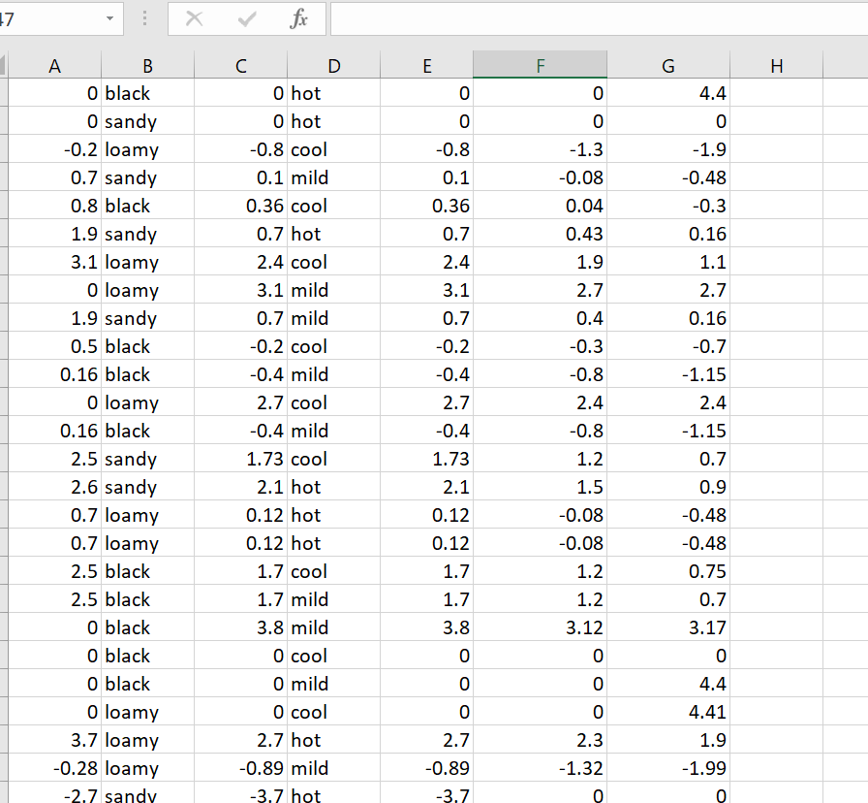
Data set

Slide 6
Implementation
F
Frontend
HTML USED TO CREATE WEB PAGE
Backend
PICKLE,FLASK USED TO CONNECT MACHINE LAERNING CODE WITH WEB PAGE

Slide 7
Flow of work
Here using libraries like pickle and flask when we given the crop id, it will display soil type, availability of water, weather suitable.
Finding data
Create dataset having features like water resource, type of soil, climate change.
Training the model
Training model done using machine learning algorithms like random forest, regression.
Testing model
Test the model and validated
Further the machine learning model is implemented to web page.
Web application
Implementation

Slide 8
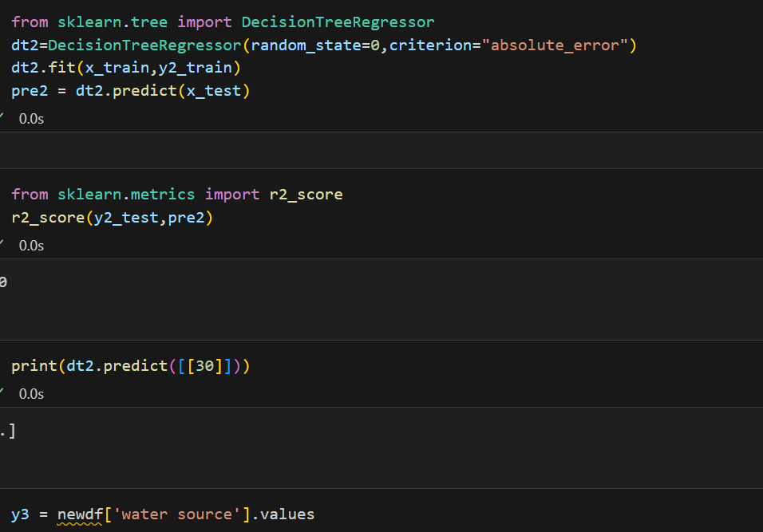
Output

Slide 9
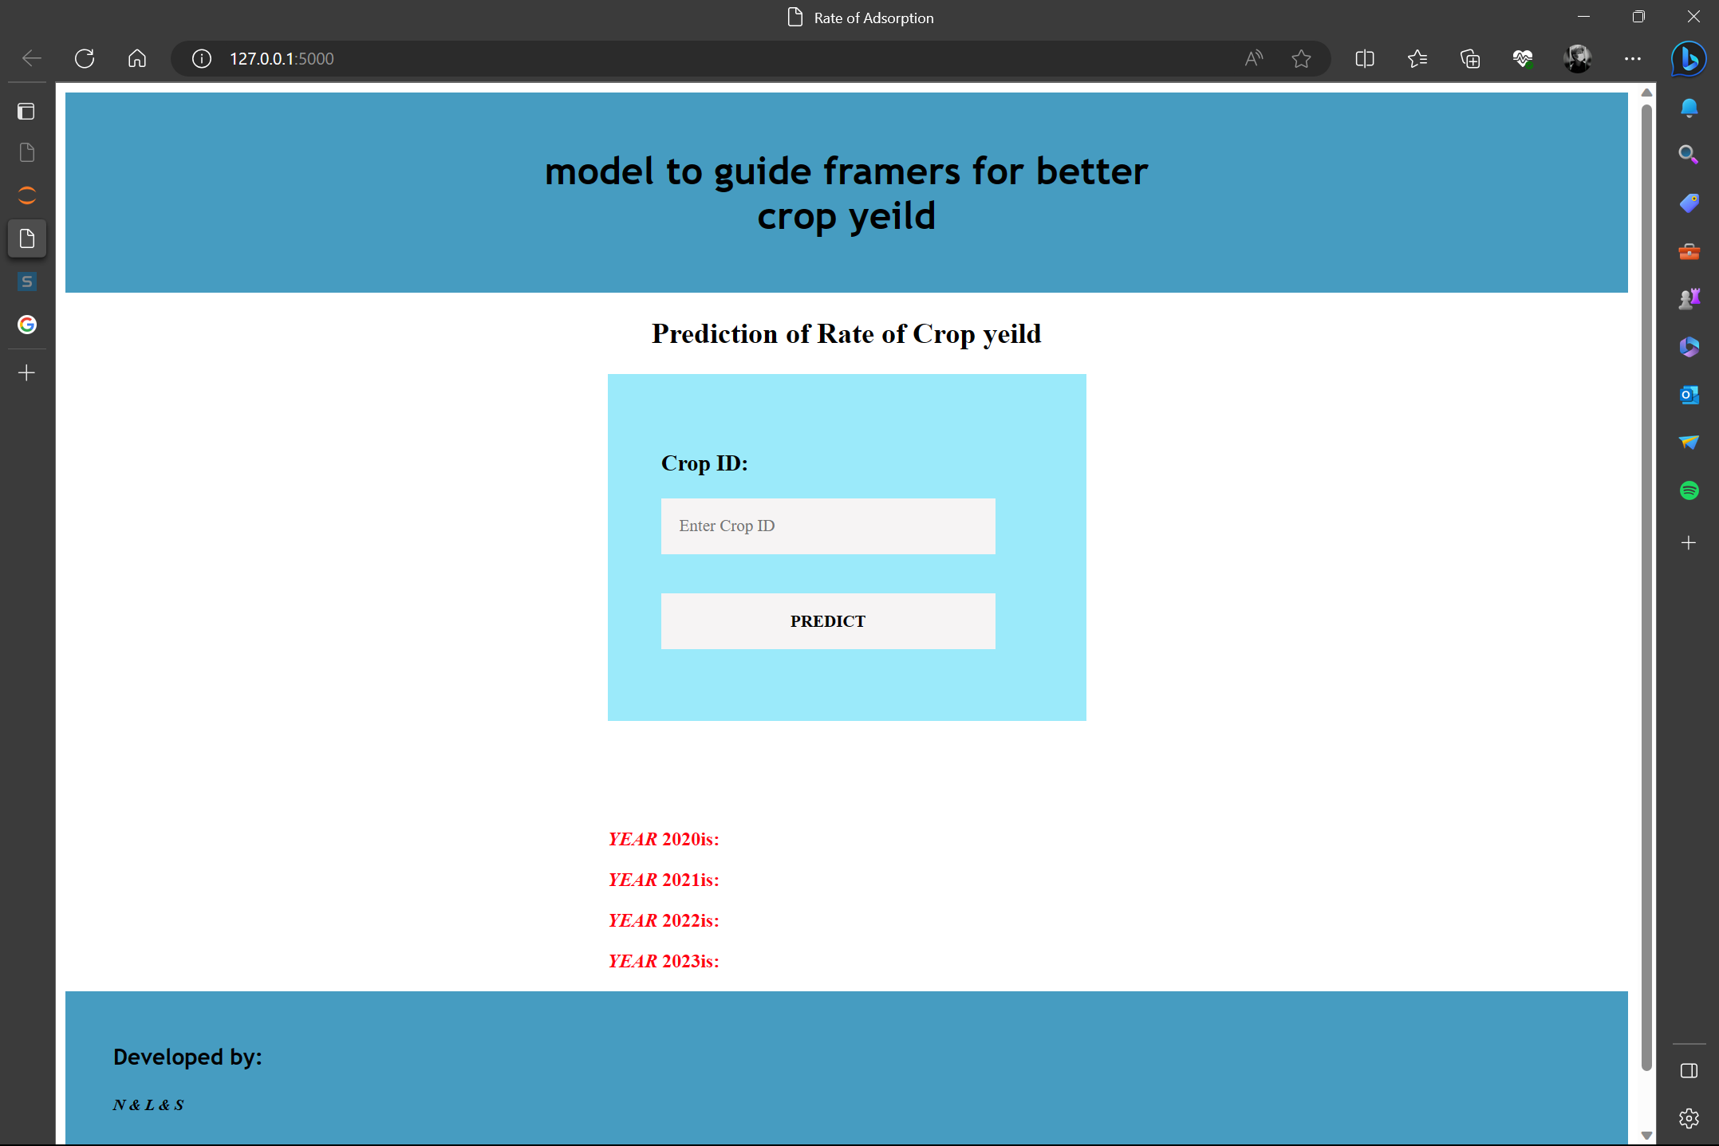
Web application

Slide 10
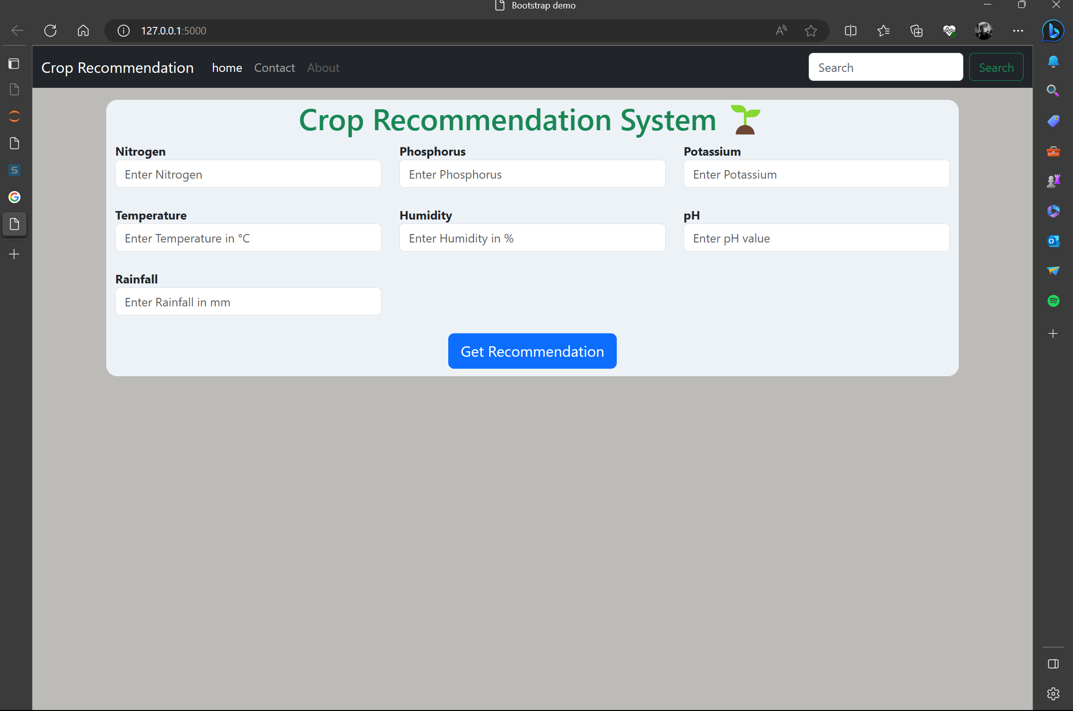
Web application-2

Slide 11
Conclusion
In conclusion, aiding farmers in the selection of crop varieties is a cornerstone to evolving sustainable, resilient, and productive agricultural systems.
By providing farmers with the right tools, knowledge, and support, we not only empower them to make informed decisions but also work towards securing the world's food supply, preserving the environment, and uplifting economies.

Slide 12
Thank you
Team 65
white hat zombies

